Slide 1




DIGITAL LITERACY
SKILLS
BASIC USERS

Slide 2

Module 5
Safety and security

Slide 3

1
Unit 1: Protecting devices

Slide 4
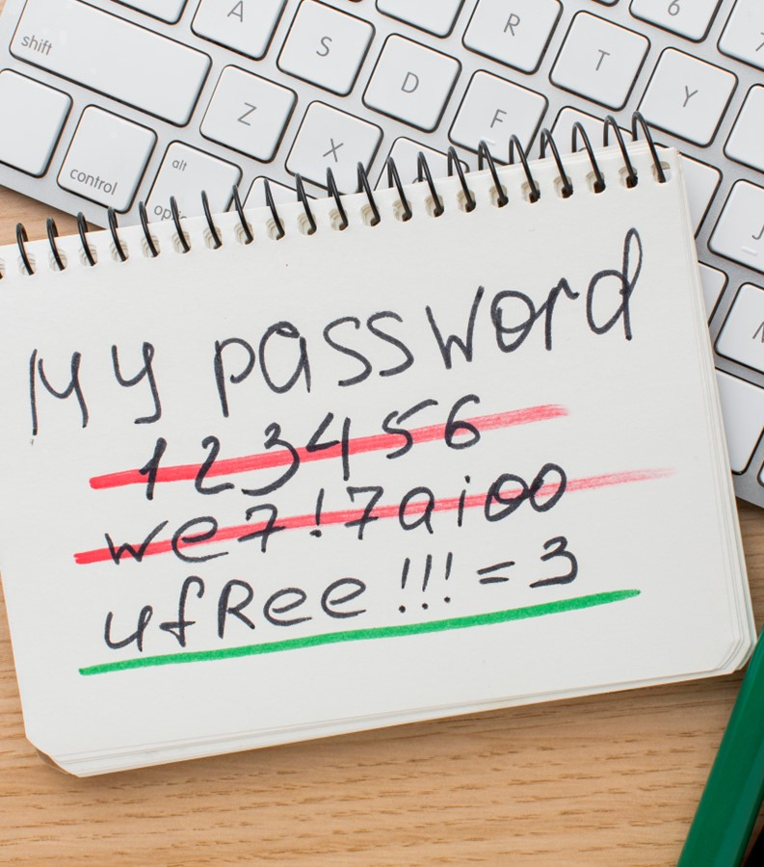
Security and passwords
Change default log-in passwords and usernames
Devices come with default passwords.
If you leave these unchanged, you create opportunities for unauthorized access.
Use strong and unique passwords
Choose strong passwords to help secure your devices.
Don’t use the same password with multiple accounts.

Slide 5
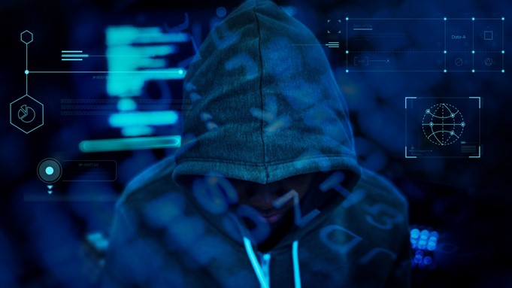
Why do you need strong passwords?
Hackers are a threat to your information.
If someone has access to your password, they could also pretend to be you.
Protect information by ensuring that only authorized people have access to it. Authenticate anyone who requests access.
Passwords only work if they are complex and private.

Slide 6
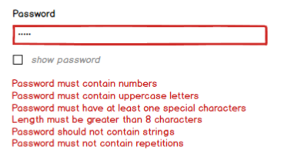
Length and complexity
Use a password or passphrase longer than the minimum allowed characters.
Include upper and lowercase letters, numbers, and special characters.
Avoid common phrases, famous quotations, and song lyrics.

Slide 7
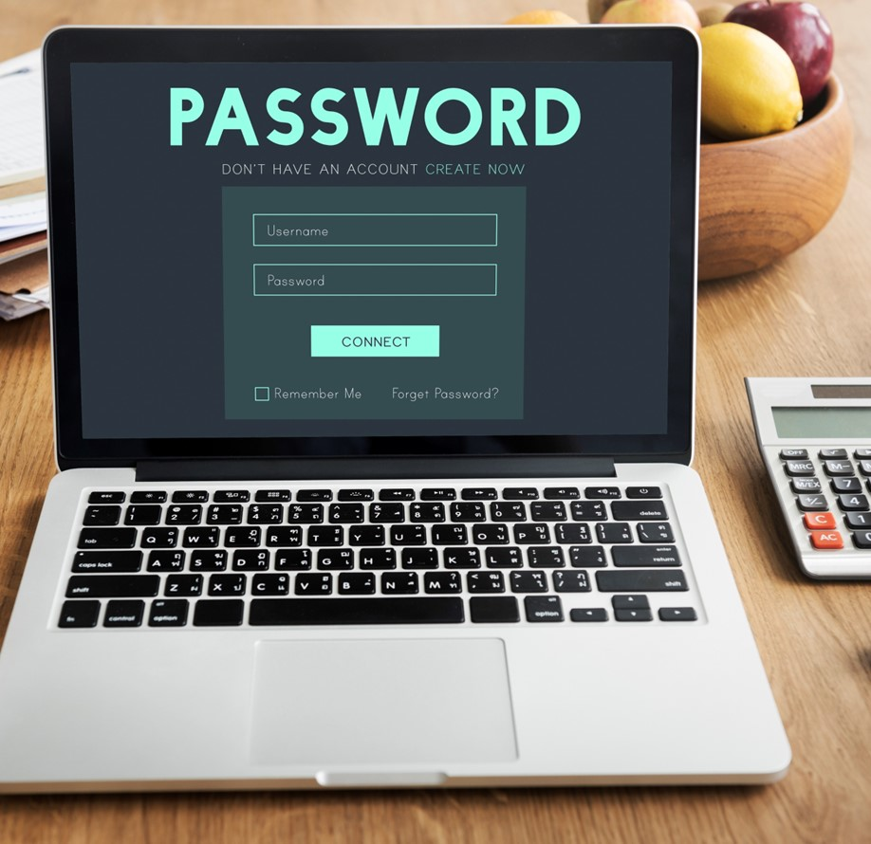
Dos and don'ts
Don’t reuse passwords. Reusing a password endangers accounts just as much as using a weak password.

Slide 8
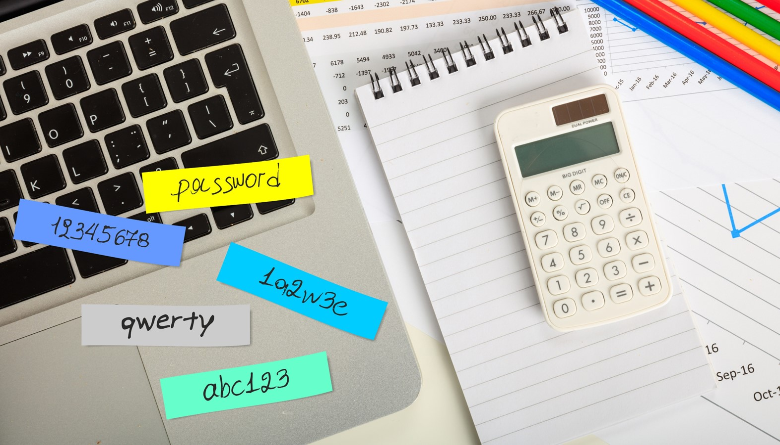
Dos and don'ts
Use these techniques to develop unique passwords for each of your accounts:
Use different passwords on different systems and accounts.
Use a password longer than the minimum allowed password.
Develop ways to remember complex passwords.
Consider using a password manager program.
Do not use passwords that are based on personal information.
Do not use words that can be found in any dictionary.

Slide 9
Improving computer security
1
2
3
Secure your home network
Secure your router – the first device that receives information from the Internet.
Home network security
Home network security – the protection of a network that connects devices – such as routers, computers, smartphones – to each other and to the Internet within a home.
Regular software updates
Update software regularly.

Slide 10

Software updates
Find software updates to install
Software updates are advertised for users to download and install.
Some software will automatically check for updates.
Avoid updating software (automatically or manually) while connected to public networks
If updates must be installed over a public network, use a Virtual Private Network (VPN) connection.

Slide 11

Best practices for software updates
Follow these guidelines about software updates:
Enable automatic software updates whenever possible.
Do not use unsupported EOL software.
Always visit supplier sites directly.
Avoid software updates while using public networks.
Disable all unnecessary services to reduce the chance of attack on your devices.
Adjust factory-default configurations on software and hardware.

Slide 12

Best practices for software updates
Follow these guidelines about software updates:
Enable automatic software updates whenever possible.
Do not use unsupported EOL software.
Always visit supplier sites directly.
Avoid software updates while using public networks.
Disable all unnecessary services to reduce the chance of attack on your devices.
Adjust factory-default configurations on software and hardware.

Slide 13
Skills to practise
Protect your device
Switch on your device, log into the device using your username and password.
If you do not have a username and password, ask your facilitator to create one for you.
Check the settings of your device on how to change your username or password. If you can’t do this, ask your facilitator to show you.
Only use devices where you have your own username and password.
Continue >

Slide 14


Skills to practise
Assess reliability of online information
Read these emails:
Ask yourself the following questions:
Have I entered a competition with a prize of UGX 50 million?
What competition requires you to pay money before receiving a prize?
Do I have any relatives who have recently died or were very wealthy?
Do you know anyone with the email of surprize@hotmail.com?
Dear Abbo
Congratulations!
You have just won UGX 50 million!
To claim your prize send UGX10,000 to surprize@hotmail.com
Dear Abbo
Congratulations!
You have just inherited UGX 50 million!
To claim your inheritance contact surprize@hotmail.com
Continue >

Slide 15
Skills to practise
If you answer no to these questions, you have received a message from a scammer.
Delete the message immediately and do not open any attachments.

Slide 16
All back covers should include
contact information of the section
producing the work.
© United Nations Children’s Fund (UNICEF) [month and year of publication]

